Slide 1

2017: Another Year
of the Snail Economy.
Greater Phoenix Chamber of Commerce
October 11th, 2016
Presented By:
Elliott D. Pollack
CEO, Elliott D. Pollack & Company
Notes:
1
1
1

Slide 2

Can the Expansion Last?
2

Slide 3
Yes!
3

Slide 4
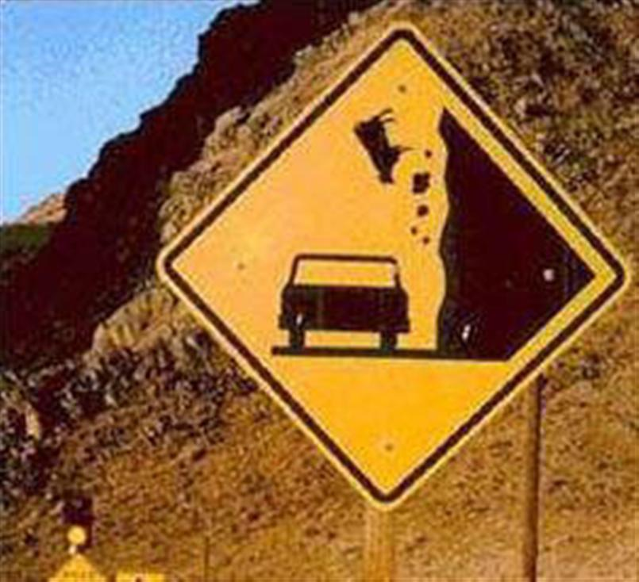
Is the Sky Falling?
4

Slide 5
Most Likely, No.
5

Slide 6
United States Real Gross Domestic Product*
Annual Growth 1970 - 2017**
Source: U.S. Bureau of Economic Analysis & Blue Chip Economic Indicators
3.5% = 40-year avg. during expansion
* Based on chained 2009 dollars.
** 2016 and 2017 are a forecast from the Blue Chip Economic Indicators, October 2016.
3.0% = 20-year avg. during expansion
Recession Periods
6
Notes:
6
6
6

Slide 7
United States Real Gross Domestic Product*
Quarterly Growth 2008 – 2016*
Source: U.S. Bureau of Economic Analysis
Recession Periods
* Based on chained 2009 dollars.
7
*Data through the second quarter 2016
Notes:
7
7
7

Slide 8
U.S. BUSINESS CYCLE EXPANSIONS
Source: National Bureau of Economic Research
Expansion Period | # of Months
October 1949 – July 1953 | 45
May 1954 – August 1957 | 39
April 1958 – April 1960 | 24
February 1961 – December 1969 | 106
November 1970 – November 1973 | 36
March 1975 - January 1980 | 58
July 1980 – July 1981 | 12
November 1982 – July 1990 | 92
March 1991 – March 2001 | 120
November 2001 – December 2007 | 73
June 2009 - Present | 87
*Data through September 2016
8

Slide 9
Average Annualized Quarterly Growth Rates
During Economic Expansions
1949 – 2016*
Source: Bureau of Economic Analysis, National Bureau of Economic Research
Expansion Period | Avg. Growth Rate
October 1949 – July 1953 | 6.4%
May 1954 – August 1957 | 3.8%
April 1958 – April 1960 | 6.2%
February 1961 – December 1969 | 4.9%
November 1970 – November 1973 | 4.4%
March 1975 - January 1980 | 4.5%
July 1980 – July 1981 | 3.2%
November 1982 – July 1990 | 4.3%
March 1991 – March 2001 | 3.6%
November 2001 – December 2007 | 2.8%
June 2009 - Present | 2.1%
9
*Data through the second quarter 2016

Slide 10
Higher now that we are deeper into the expansion.
RISKS
The Election - Assume both major-party candidates are lying.
10

Slide 11
Long term growth is negatively affected by:
Higher Tax Rates
Burdensome and Capricious Regulation
Barriers to International Trade
Barriers to Credit Creation
11

Slide 12
It’s time to be a little cautious.
12

Slide 13
But, the Expansion can last.
13

Slide 14

Where We Stand–
The expansion is starting to show signs of middle age.
YOU ARE SOMEWHERE AROUND HERE
14

Slide 15
Expansions don't die of old age.
15

Slide 16
As recoveries get older, they become more vulnerable to shocks...
…Just as people get older they become more vulnerable to diseases.
16

Slide 17
They die because an economy becomes vulnerable to exogenous shocks or asset bubbles or a tightening in the credit market.
17

Slide 18
U.S. Leading Indicators
1960 – 2016*
Source: The Conference Board
Recession Periods
18
*Data through August 2016

Slide 19
Consumer Confidence
1978 – 2016*
Source: The Conference Board
Recession Periods
19
*Data through September 2016

Slide 20
Treasury Spread:
10 year bond rate less 3 month bill rate
1959 – 2016*
Source: Federal Reserve Bank of New York
Recession Periods
20
*Data through August 2016
Notes:
20
20

Slide 21
Treasury Spread:
Recession Probabilities
1960 – 2017*
Source: Federal Reserve Bank of New York
Recession Periods
21
*Data through August 2017
Notes:
21
21

Slide 22
U.S. Inventories to Sales Ratio
1992 – 2016*
Source: U.S. Census Bureau
Inventories to Sales Ratio is out of Line
Recession Periods
22
*Data through July 2016.
Ratio: Total Business Inventories/Total Business Sales

Slide 23
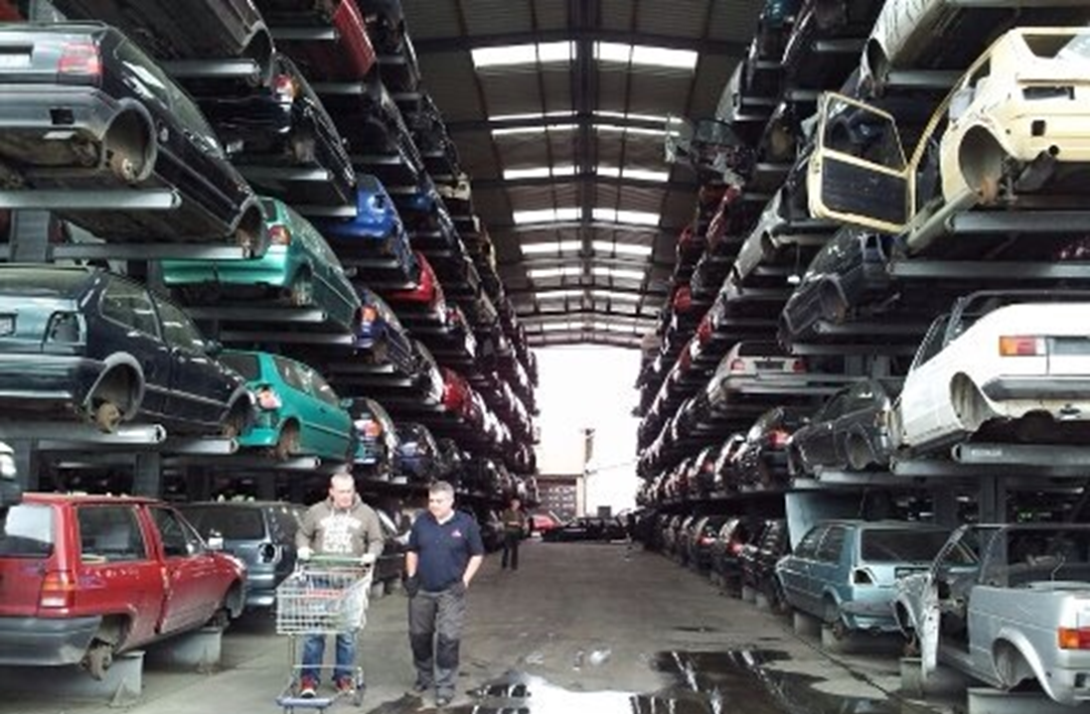
Excess inventory, mainly in autos.
23

Slide 24
Average Age of Auto Fleet (all light vehicles)
2015 – 11.5 years
2014 – 11.4 years
2013 – 11.3 years
2010 – 10.6 years
2005 – 9.5 years
2000 – 8.9 years
1995 – 8.4 years
Source: R.L. Polk Company, IHS
24
Notes:
24
24
24
24

Slide 25

Conclusion
The possibility of a recession today is higher than it was earlier in the cycle. But Still Low!
25

Slide 26

Consumers
Debt burden low
26

Slide 27
Financial Obligation Ratio*
1980 – 2016**
Source: Federal Reserve
Recession Periods
*Ratio of mortgage and consumer debt (including auto, rent and tax payments) to disposable income.
**Data through the second quarter 2016
27
Notes:
27
27
27

Slide 28
U.S. Consumer Credit
1980 – 2016*
Source: Federal Reserve
(Trillions)
Recession Periods
*Data through August 2016
28
Revolving credit remains more than $47.2 billion below its 2008 peak.
Notes:
28
28

Slide 29

Consumer Liquidity Improving
29

Slide 30

No irrational exuberance
30

Slide 31

Net worth improved
31

Slide 32

Real income growth
32

Slide 33
Real Disposable Personal Income Per Capita
1970-2016*
Source: Bureau of Economic Analysis
Recession
*Data through the second quarter 2016
33

Slide 34

Inflation low
34

Slide 35

No capacity issues
35

Slide 36

Government
Not a drag on economy
TOO BUSY TO MESS UP THE COUNTRY TODAY
36

Slide 37
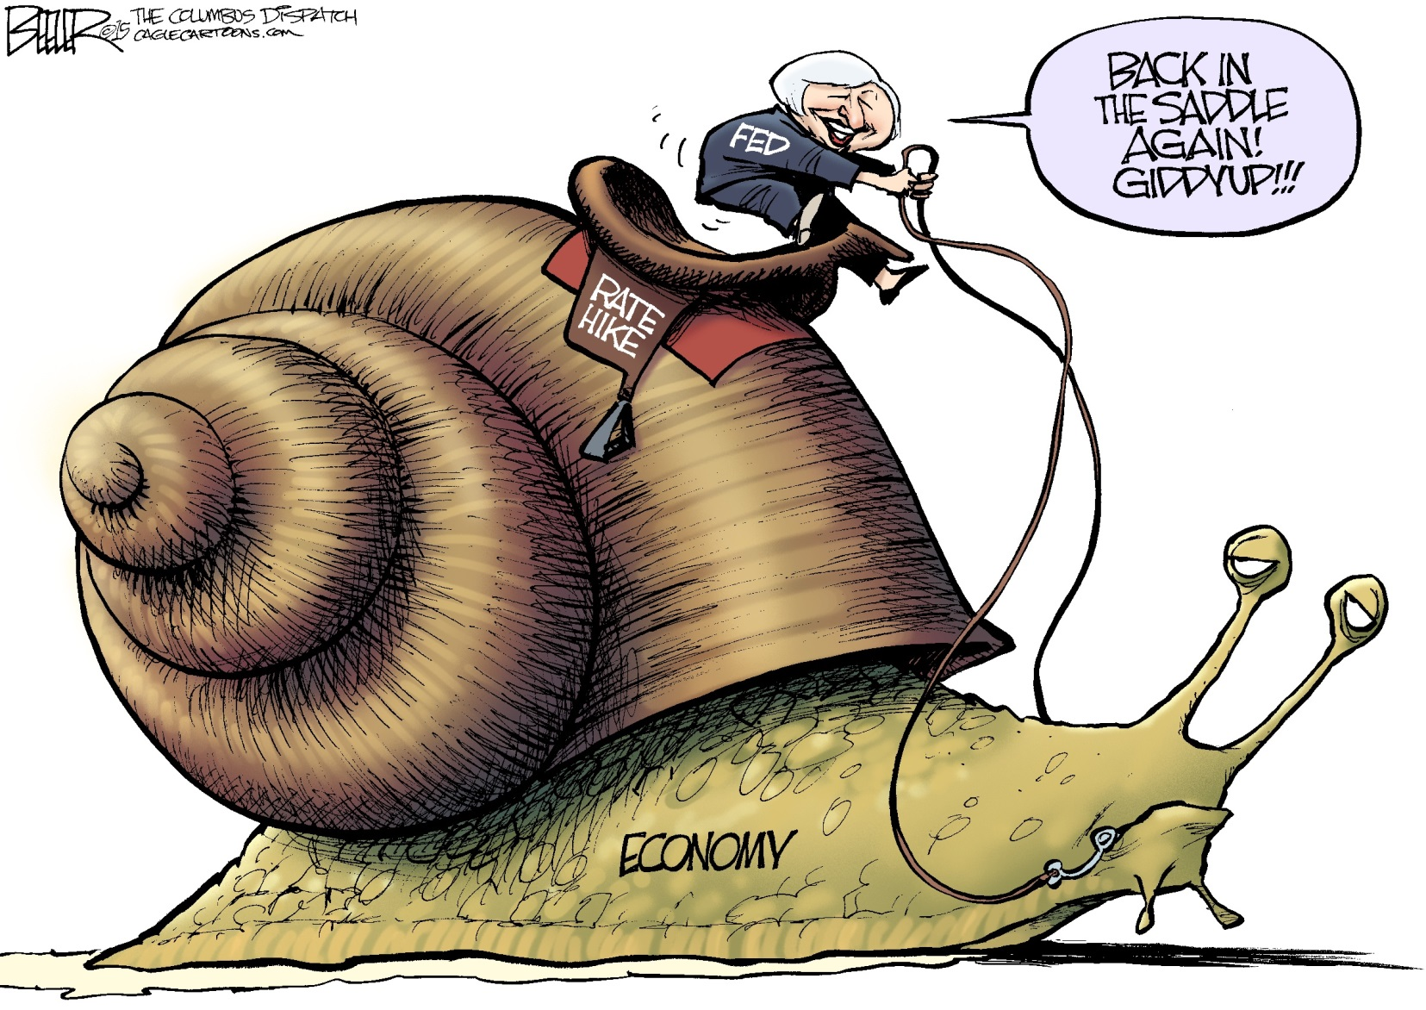
Fed policy still expansive
37

Slide 38

Housing
Prices up, but modestly
38

Slide 39
NATIONAL ECONOMY –
Continued subpar growth.
But, expansion should continue.
39

Slide 40

Bottom Line
Slow Intermediate Term Growth
40
Notes:
40
40
40
40

Slide 41
Greater Phoenix
(73% total non-farm Employment
in the state)
41
Notes:
41

Slide 42
Employment Growth
From Bottom of Recession to Now
Seasonally Adjusted
Source: BLS
Area | % Change | % of Arizona Growth | 2015 Annual Wages
United States | 10.9% |  | $52,876
Arizona | 13.7% | 100.0% | $47,492
Greater Phoenix | 16.7% | 86.2% | $49,903
Greater Tucson | 7.1% | 7.7% | $41,676
Balance of State | 6.0% | 6.2% | $35,733
Note: Start of Recession Sept. 2010 to August 2016
Wages for Private industries
42

Slide 43
Arizona–
The State has had a significant recovery in both absolute and relative terms.
It is only when we compare ourselves to previous Arizona recoveries that we look so bad.
43

Slide 44

The World has Changed…
Pre-2007 Post-2007
44
Notes:
44

Slide 45
Arizona Employment Growth
Arizona’s Rank Out of 50 States
Source: Arizona State University, U.S. Bureau of Labor Statistics
Year | Rank
1993 | 5
1994 | 2
1995 | 2
1996 | 2
1997 | 2
1998 | 1
1999 | 2
2000 | 5
2001 | 9
2002 | 10
2003 | 4
2004 | 2
Year | Rank
2005 | 2
2006 | 2
2007 | 17
2008 | 46
2009 | 49
2010 | 49
2011 | 27
2012 | 8
2013 | 9
2014 | 17
2015 | 11
2016* | 8
*YTD August 2016 vs. YTD August 2015
45
Notes:
45
45
45
45

Slide 46
Phoenix-Mesa-Scottsdale Employment Growth
(Ranking among all metro areas greater than 1,000,000)
Source: Arizona State University, U.S. Bureau of Labor Statistics
Year | Rank | # MSA’s
1993 | 2 | 19
1994 | 1 | 19
1995 | 1 | 20
1996 | 1 | 21
1997 | 2 | 22
1998 | 1 | 23
1999 | 3 | 24
2000 | 7 | 25
2001 | 7 | 26
2002 | 5 | 25
2003 | 3 | 25
2004 | 3 | 25
Year | Rank | # MSA’s
2005 | 1 | 26
2006 | 1 | 27
2007 | 10 | 29
2008 | 25 | 29
2009 | 23 | 24
2010 | 23 | 23
2011 | 14 | 25
2012 | 10 | 28
2013 | 7 | 29
2014 | 15 | 31
2015 | 11 | 32
2016* | 6 | 32
*YTD August 2016 vs. YTD August 2015
46
Notes:
46
46
46
46

Slide 47
Why has Arizona growth in this cycle been subpar relative to its
historical norm?
47

Slide 48
Sub normal national recovery
(2) Slowdown in population flows
Nationally and in Arizona
(3) Local factors
48

Slide 49

What has changed?
49

Slide 50
Growth itself is an economic driver in Arizona–
People moving to the State creates demand for goods and services that create more jobs.
When you grow at 1.8% instead of 3.2%, the part of the economy that is based on servicing new people shrinks.
50

Slide 51
Greater Phoenix Unemployment Rate
1990 – 2016*
Source: Bureau of Labor Statistics
Recession Periods
*Data through August 2016
51
Notes:
51
51

Slide 52
Employment Growth
From Bottom of Recession (Start of Recovery)
Greater Phoenix Employment, Seasonally Adjusted
Source: BLS
Recession | Emp. Trough | 71 mos. Later | % Growth | Avg. Monthly Gain
1974-1975 | Dec-74 | Nov-80 | 45.7% | 0.64%
1981-1982 | Sep-82 | Aug-88 | 43.6% | 0.61%
1991 | Aug-91 | Jul-97 | 37.9% | 0.53%
2001 | Dec-01 | Nov-07 | 21.6% | 0.30%
2007-2009 | Sep-10 | Aug-16 | 16.7% | 0.23%
52

Slide 53
Population Growth after Recessions
Greater Phoenix
Source: ADOA
Start of Recovery | Population | Population 6 years later | % Growth | Avg. Annual Growth
1975 | 1,337,700 | 1,658,988 | 20.4% | 4.0%
1981 | 1,658,988 | 2,102,571 | 26.7% | 4.5%
1991 | 2,301,825 | 2,900,325 | 26.0% | 4.3%
2001 | 3,360,062 | 4,087,390 | 21.6% | 3.6%
2009 | 4,186,130 | 4,482,906 | 7.1% | 1.2%
53

Slide 54

Fewer people mean fewer houses & less commercial construction.
54

Slide 55
Greater Phoenix Employment*
Annual Percent Change 1976–2017**
Source: Arizona Department of Administration
Pre-2008 Avg. 4.8%
*Non-agricultural wage & salary employment. Changed from SIC to NAICS reporting in 1990.
**2016 & 2017 forecasts from Elliott D. Pollack & Co. as of June 2016.
Recession Periods
55

Slide 56
Arizona Jobs Regained Since Bottom of Cycle–
Most Industries Yet to Regain Lost Jobs
Source: U.S. Bureau of Labor Statistics, Thousands of Jobs, Seasonally Adjusted, August 2016.
56

Slide 57
Share of Total Non-farm Employment
Source: Bureau of Labor Statistics, U of A Forecasting Project
Industry | Manufacturing |  | Professional and Business Services |  | Educational and Health Services
Year | U.S. | Greater Phoenix | U.S. | Greater Phoenix | U.S. | Greater Phoenix
1975 | 21.9% | 17.4% | 7.8% | 9.5% | 7.1% | 7.1%
1980 | 20.7% | 17.2% | 8.3% | 9.0% | 7.8% | 7.1%
1985 | 18.3% | 15.0% | 9.1% | 10.4% | 8.9% | 7.6%
1990 | 16.2% | 13.4% | 9.9% | 10.9% | 10.1% | 9.0%
1995 | 14.7% | 12.1% | 10.9% | 13.7% | 11.4% | 9.2%
2000 | 13.1% | 10.2% | 12.6% | 16.7% | 11.6% | 8.7%
2005 | 10.6% | 7.6% | 12.6% | 16.5% | 13.2% | 10.4%
2010 | 8.8% | 6.5% | 12.8% | 16.0% | 15.3% | 14.1%
2015 | 8.7% | 6.3% | 13.9% | 16.8% | 15.5% | 14.7%
57

Slide 58
2015 Average Annual Wages
Source: U.S. Bureau of Labor Statistics
Industry | U.S. | Greater Phoenix | % of U.S.
All Industries | $52,876 | $49,903 | 94.4%
Natural resources and mining | $58,461 | $48,385 | 82.8%
Construction | $57,009 | $52,223 | 91.6%
Manufacturing | $64,305 | $73,002 | 113.5%
Trade, trans., and utilities | $44,321 | $45,549 | 102.8%
Information | $95,098 | $67,060 | 70.5%
Financial activities | $87,915 | $67,235 | 76.5%
Professional and business services | $69,270 | $54,947 | 79.3%
Education and health services | $47,383 | $49,911 | 105.3%
Leisure and hospitality | $21,807 | $23,309 | 106.9%
Other services | $35,116 | $35,142 | 100.1%
Note: Wages for Private industries
58

Slide 59
Labor Force Participation Rate (16 years and over)
1986 – 2014
Source: Bureau of Labor Statistics
Recession Periods
59

Slide 60
Where are the Inflows of Population?
60

Slide 61
For the U.S. as a Whole
      2001 – 2005
      2011 – 2015
Total Movers down 25.9%
  Movers from abroad (down 21.3%)
  Movers from other states (down 35.9%)
  Movers from other counties
  in the state (down 16.2%)
Note: Does not include in-state movers
61

Slide 62
U.S. Population Flows
Source: U.S. Census Bureau
YEAR | % of Pop Moved | % of Movers in the Same County | % of Movers From Abroad | % of Movers From Other States | % of Movers From Other Counties in State
2000 | 16.1% | 56.2% | 4.0% | 19.4% | 20.3%
2005 | 13.9% | 57.0% | 4.7% | 18.7% | 19.7%
2010 | 12.5% | 69.2% | 2.6% | 11.5% | 16.6%
2015 | 11.6% | 63.1% | 4.6% | 14.0% | 18.3%
62

Slide 63
Arizona Capture Rate
(from abroad and between states)
      2001 – 2005 = 7.6%
      2011 – 2015 = 3.2%
Note: Does not include in-state movers
63

Slide 64
Arizona Capture Rates
YEAR | Capture Rate
2000 | 6.4%
2005 | 10.4%
2010 | 2.4%
2015 | 3.7%
64

Slide 65
Conclusion:
Due to the lack of national, international, and in state population flows:
1. Jobs that would have been created by the domestic demand from people moving here slowed.
2. It took longer to absorb the excess inventory of single family, office, etc. Construction employment has suffered.
65

Slide 66
Population Growth 2015
Source: U.S. Census Bureau
Alaska
39
7
15
1
9
11
32
3
16
6
2
19
Hawaii
8
44
10
Growing
5
Top 10
4
Declining
66
Notes:
66
66
66
Updated 5/17/2013

Slide 67
Greater Phoenix Population
Annual Percent Change 1975–2017*
Source: AZ Dept. of Administration, EDPCo
Recession Periods
Pre-2008 Avg. 3.5%
67
*2016 and 2017 forecasts from Elliott D. Pollack & Co. as of June 2016.

Slide 68
How quickly are population flows going to recover?
68

Slide 69

SLOWLY!
Still buffering, seriously?
69

Slide 70
Greater Phoenix Population
Source: U.S. Census Bureau; AZ Dept. of Administration; University of Arizona Forecasting Project; EDPCo
Greater Phoenix Population Estimates and Projections
Population | 2015 | 2016 | 2017
EDPCo Forecast as of June 2016 | 4,482,906 | 4,572,564 | 4,668,588
Net Change | 78,018 | 89,658 | 96,024
% Change | 1.8% | 2.0% | 2.1%
U of A Forecasting Project Forecast as of 2016 Q3 | 4,482,906 | 4,567,426 | 4,661,325
Net Change | 78,018 | 84,520 | 93,899
% Change | 1.8% | 1.9% | 2.1%
Arizona Dept. of Administration Forecast as of 2015 Q4 | 4,482,906 | 4,569,800 | 4,661,600
Net Change | 78,018 | 86,894 | 91,800
% Change | 1.8% | 1.9% | 2.0%
70
Notes:
70

Slide 71
Greater Phoenix Population
Source: U.S. Bureau of Census; Arizona Department of Administration; University of Arizona Forecasting Project
YEAR | POPULATION | APR
1960 | 726,183 | 6.9%
1970 | 1,039,807 | 3.7%
1980 | 1,600,093 | 4.4%
1990 | 2,238,498 | 3.4%
2000 | 3,251,876 | 3.8%
2010 | 4,192,887 | 2.6%
2015 | 4,482,906 | 1.3%
2020* | 4,956,480 | 2.0%
2025* | 5,444,540 | 1.9%
*Forecasts as of 2016 Q3
71
Notes:
71

Slide 72

Housing Market Outlook
72

Slide 73
If you believe that
population forecast,
it implies an average of
about 20,000 single family units will be built each year
from 2015 through 2020.
73

Slide 74

Parade of Horribles for
Housing is Less Scary
74

Slide 75
What is keeping potential buyers out of the housing market?
Parade of horribles:
Negative Equity
Foreclosures
Millennials
Student Loans
Tougher Loan Standards
FHA Loan Limit
75

Slide 76
Phoenix MSA
Annual Homeownership Rates
1986–2015
Source: U.S. Census Bureau
Recession Periods
76

Slide 77
U.S. and Arizona
Negative Equity Share
Plus Near Negative Equity Share
2010–2016
Source: CoreLogic
Near Negative Equity: Loan-to-value ratio equals 95 to less than 100
77

Slide 78
Maricopa County Foreclosure Lag
2002–2023
Source: Information Market
Recession Periods
78

Slide 79
Mortgage Credit Availability Index
2012 – 2016*
March 2012 = 100
Source: Mortgage Bankers Association
180
160
140
120
100
80
2012
2013
2014
2015
2016
*A decline in the MCAI indicates that lending standards are tightening,
while increases in the index are indicative of loosening of credit.
*Data through August 2016
79

Slide 80
Mortgage Credit Availability Index
2004 – 2016*
March 2012 = 100
Source: Mortgage Bankers Association
Recession Periods
1,000
750
500
250
0
2004
2006
2008
2010
2012
2014
*A decline in the MCAI indicates that lending standards are tightening,
while increases in the index are indicative of loosening of credit.
*Data through August 2016
80

Slide 81

Millennials
81

Slide 82
U.S. Birth Index
1909-2015
Source: U.S. Census Bureau; Harvard Joint Center for Housing Studies
Baby Boomers
1945-1964
(Ages 50-69)
78.7 M
Gen X
1965-1984
(Ages 30-49)
69.5 M
82
Notes:
82
82

Slide 83
Percent of 18-33 Year Olds Married
Source: Pew Research
In 1960 - 64% were married (Silent Generation)
In 1980 - 49% were married (Baby Boomers)
In 1997 - 38% were married (Gen X)
In 2014 - 28% were married (Millennials)
83

Slide 84

When you delay marriage you delay children. That delays housing. That delays demand for housing “stuff”.
84

Slide 85
Total Student Loan Debt Has Quadrupled!
85

Slide 86
Total Student Loan Balances
Billions of Dollars
Source: Federal Reserve Bank of New York Consumer Credit Panel / Equifax
Year | TOTAL
2004 Q2 | $262.9
2005 Q2 | $374.4
2006 Q2 | $438.9
2007 Q2 | $514.0
2008 Q2 | $586.3
2009 Q2 | $675.4
2010 Q2 | $761.7
2011 Q2 | $851.4
2012 Q2 | $914.0
2013 Q2 | $994.0
2014 Q2 | $1,118.0
2015 Q2 | $1,190.0
2016 Q2 | $1259.0
86
Notes:
86
86

Slide 87
Expenses that Delayed Saving for a Down Payment or Home Purchase - 2015
By Age
Source: National Association of Realtors 2015
 | All Buyers | 35 and younger | 35 to 50 | 51 to 60 | 61 to 69 | 70 to 90
Student Loans | 51% | 53% | 31% | 9% | 5% | 3%
Credit Card Debt | 47% | 35% | 44% | 36% | 23% | 19%
Car Loan | 35% | 31% | 20% | 17% | 7% | 6%
Child Care Expenses | 18% | 14% | 18% | 6% | 2% | *
Health Care Costs | 13% | 10% | 9% | 13% | 13% | 11%
Other | 17% | 17% | 24% | 46% | 62% | 71%
Median Years Delayed | 3 | 3 | 4 | 5 | 6 | 5
87
Notes:
87
87

Slide 88
FICO Score Distribution
Percent of Population
April 2016
Source: Fair Isaac Corporation
27% under Fannie/Freddie 620 minimum
61% under Fannie/Freddie 749 average
88

Slide 89
Student Loan Impact on Economy
If people are paying student loan debt, they are not buying houses, furniture, beers, etc. Unless incomes are higher because of their degree.
89

Slide 90

The housing recovery is likely to continue.
90

Slide 91
Single Family Permits
Greater Phoenix 1975–2017*
Source: RL Brown & Elliott D. Pollack & company
# Permits
(000)
*2016 and 2017 forecast is from Elliott D. Pollack & Company
as of second quarter 2016.
91
Notes:
91

Slide 92
Population Change to Single Family Permit Ratio
1975-2015
Source: UofA Forecasting Project, U.S. Census Bureau, ADOA
Recession Periods
92

Slide 93
Population Change to Total Permits Ratio
1975-2015
Source: UofA Forecasting Project, U.S. Census Bureau, ADOA
Recession Periods
93

Slide 94
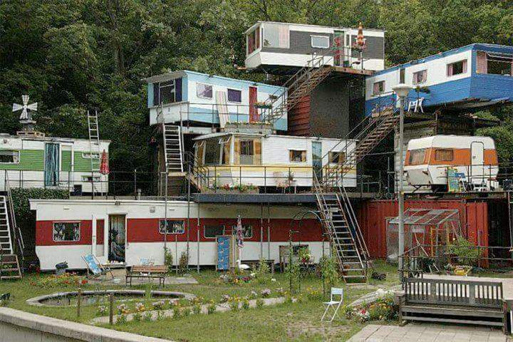
Multi-Family
94

Slide 95
Apartments
Births ➔26 year lag
1955-2038
Source: U.S. Census Bureau
2016
95
Notes:
95
95

Slide 96
Retirement Home Cycle
Births ➔ 65 year lag
1994-2076
Source: U.S. Census Bureau
96
Notes:
96
96

Slide 97
U.S. Median Age at First Marriage
1890-2015
Source: U.S. Census Bureau
97

Slide 98
Multi-Family Average Rent Percent Change a Year Ago
2004 – 2016*
Source: RealData Inc.
Recession Periods
*Data through second quarter 2016
98

Slide 99
Multi-Family Year-End Vacancy Rates
Greater Phoenix County 1975–2017*
Source: ASU Realty Studies / Berkadia**
Recession Periods
*2016 & 2017 are forecasts from Elliott D. Pollack & Co.
**Data prior to 2005 is from ASU
99
Notes:
99
99

Slide 100
Multi-Family Housing Market
Source: PMHS, Kasten Long, and RealData
 | Absorption | Completions
2007 | (5,846) | 4,637
2008 | (4,466) | 7,037
2009 | (5,319) | 6,737
2010 | 20,743 | 698
2011 | 2,154 | 910
2012 | 3,028 | 2,031
2013 | 4,822 | 4,452
2014 | 4,716 | 5,658
2015 | 3,728 | 6,720
100
Notes:
10/08/2013

Slide 101
Multi-Family Pipeline
Source: Anonymous
Year | Potential New Supply
2016 | 5,669
2017 | 4,537
2018 | 5,148
101

Slide 102

OFFICE
102
Notes:
102
102

Slide 103
Office Space Year-End Vacancy Rates
Greater Phoenix 1986–2017*
Source: CBRE
Recession Periods
*2016 & 2017 are forecasts from Greater Phoenix Blue Chip.
103
Notes:
24
103
103
103

Slide 104
Greater Phoenix Office Market*
Source: CBRE
Year | Absorption (sf) | Chg in Inventory (sf)
2005 | 3,119,293 | 7,987
2006 | 3,245,888 | 2,320,302
2007 | 1,500,704 | 4,905,374
2008 | (603,112) | 3,402,646
2009 | (667,329) | 1,798,415
2010 | 233,670 | 2,011,404
2011 | 1,857,433 | 3,144,910
2012 | 2,020,529 | 973,282
2013 | 1,721,366 | (35,566)
2014 | 1,969,716 | 1,107,906
2015 | 3,779,039 | 3,763,828
2016** | 2,003,933 | 451,206
*All Leased multi-tenant space greater than 10,000 SF.
** Data through the second quarter 2016
104
Notes:
10/08/2013

Slide 105
As of 2016, the following markets have vacancy rates under 10%
Deer Valley/Airport
Tempe
Scottsdale South
PS Peak
Source: Paul Johnson
105

Slide 106
Under any reasonable employment growth scenario,
we believe it will be 2018 before any significant office construction occurs
(although some sub-markets like Tempe and downtown Scottsdale
will be sooner).
106
Notes:
106
106

Slide 107
As of the second quarter 2016,
there were 1.8 million square feet of total office space under construction including 987,605 square feet of speculative office space.
Source: CBRE
107
Notes:
107
107

Slide 108
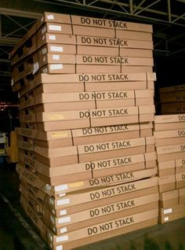
INDUSTRIAL
108
Notes:
108
108

Slide 109
Industrial Space Vacancy Rates
Greater Phoenix 1980 – 2017*
Source: CBRE
Recession Periods
109
*2016 & 2017 are forecasts from the Greater Phoenix Blue Chip
Notes:
24
109
109
109

Slide 110
Greater Phoenix Industrial Market
Source: CBRE
Year | Absorption (sf) | Chg in Inventory (sf)
2005 | 13,349,129 | 7,072,477
2006 | 6,032,175 | 7,829,959
2007 | 8,359,835 | 13,914,181
2008 | 629,838 | 13,467,215
2009 | (4,649,352) | 4,753,218
2010 | 4,455,097 | 2,451,202
2011 | 7,753,111 | 2,842,185
2012 | 7,405,168 | 3,358,724
2013 | 8,783,982 | 8,902,571
2014 | 6,214,680 | 6,791,313
2015 | 7,046,663 | 3,966,434
2016* | 5,021,394 | 2,492,687
*Data through the second quarter 2016
110
Notes:
10/08/2013

Slide 111
As of the second quarter 2016,
there was 3.5 million square feet of total industrial space under construction including
2.1 million square feet
of speculative industrial space.
Source: CBRE
111
Notes:
111
111

Slide 112

RETAIL
112

Slide 113
Retail Space Vacancy Rates
Greater Phoenix 1985–2017*
Source: CBRE**
Recession Periods
*2016 & 2017 are forecasts from the Greater Phoenix Blue Chip
** Data prior to 1992 is from Grubb & Ellis
113
Notes:
113
113

Slide 114
Greater Phoenix Retail Market
Source: CBRE
Year | Absorption (sf) | Chg in Inventory (sf)
2005 | 6,708,155 | 6,248,789
2006 | 5,244,597 | 4,582,618
2007 | 9,424,362 | 11,104,865
2008 | 3,395,986 | 6,229,205
2009 | (1,117,100) | 4,405,985
2010 | (75,352) | 902,380
2011 | (152,647) | 24,543
2012 | 1,879,005 | 184,932
2013 | 1,579,202 | (325,959)
2014 | 1,487,313 | (49,225)
2015 | 1,150,192 | 164,859
2016* | 521,159 | 421,077
114
*Data through the second quarter 2016
Notes:
10/08/2013

Slide 115
As of the second quarter 2016,
there were 918,961 square feet of total retail space
under construction and 0 square feet of speculative retail
construction.
Source: CBRE
115
Notes:
115
115

Slide 116
Greater Phoenix Retail Sales
Percent Change Year Ago*
1999 – 2016**
Source: Arizona Department of Revenue
Recession Periods
*Data through July 2016
**3-month moving average
Note: January 2010 and March 2010 retail sales are estimates.
116
Notes:
116
Up-to-date

Slide 117
E-Commerce Retail Sales as a Percent of Total Sales
2000 – 2016*
Source: U.S. Census Bureau
Recession Periods
117
*Data through the second quarter of 2016

Slide 118

Real Estate Recap
118

Slide 119
The Greater Phoenix real estate market has made a significant recovery from the bottom of the Great Recession.
119

Slide 120
But, it is still way down from the previous peak in terms of absorption.
120

Slide 121
The lower than typical rate of growth in population (relative to past recoveries) has lead a slower recovery.
121

Slide 122
Thus, while there has been a significant recovery, it is weak by historic standards.
122

Slide 123
Most of the parade of horribles related to the housing market are on the mend.
123

Slide 124
Single family permits went from 63,545 in 2005 to 6,794 in 2010 to about 18,000 in 2016.
Source: R.L. Brown
124

Slide 125
Retail absorption went from 6,708,155 in 2005 to (1,117,100) in 2009 to 1,150,193 in 2015
Source: CBRE
125

Slide 126
The recovery should continue. Excess supplies of residential and commercial properties have, for the most part, been absorbed.
126

Slide 127

The World has Changed…
Pre-2007
127
Notes:
127

Slide 128

The World has Changed…
Post-2007
128
Notes:
128

Slide 129

OVERALL CONCLUSIONS:
How will it all turn out?
129

Slide 130
Greater Phoenix–
No traditional boom in Greater Phoenix until population increases more rapidly.
130

Slide 131
Given where we are in the cycle, this is the new “Boom!”
131

Slide 132
“It’s as good as it gets!”
132

Slide 133

133

Slide 134
Greater Phoenix Forecasts
 | Actuals |  | Forecast
 | 2014 | 2015 | 2016 | 2017
Population | 1.5% | 1.8% | 2.0% | 2.1%
Employment | 2.3% | 3.3% | 3.4% | 3.6%
Construction Employment | 2.3% | 3.5% | 10.0% | 12.0%
Manufacturing Employment | 0.9% | 1.1% | 1.0% | 1.0%
Retail Sales | 4.9% | 8.9% | 5.0% | 5.0%
Permits | -15.2% | 46.7% | 20.0% | 10.0%
Personal Income | 5.1% | 4.8% | 5.2% | 5.3%
134

Slide 135

For a quick analysis of important economic data released each week, subscribe to the
Monday Morning Quarterback www.arizonaeconomy.com
(Click on Subscribe to MMQ)
135

