Slide 1
The UK, the European Union and the Global Economy
Andrew Walker, BBC Economics Correspondent

Slide 2
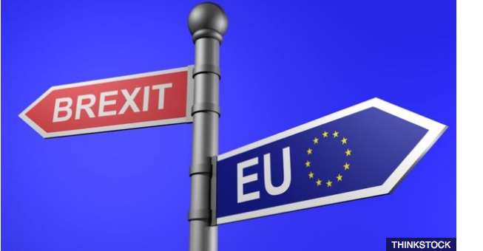
We have voted for it, but it hasn’t happened yet
Uncertainty about exactly what it will look like

Slide 3
Short term Macroeconomic effects
Confidence – moderate reaction
Sterling sharp falls (15+%)

Slide 4
Short term continued
Stock and bond markets apparently strong
Bank of England/monetary policy (rate cut/QE)
Short lived political uncertainty

Slide 5
Forecasts for UK
Generally marked down
IMF 1.8% for 2016, 1.1% for 2017
Pre-referendum forecast was 1.9% and 2.2%
“political and economic uncertainties that threaten to dampen investment and hiring throughout Europe”

Slide 6
But ….
Economists for Brexit say
IMF “continues to behave like a failed horse racing tipster”
2.6% this year and next

Slide 7
No sign of a “Brexit recession”
“As the available information grows, the referendum result appears, so far, not to have had a major effect on the UK economy. So it hasn’t fallen at the first fence but longer-term effects remain to be seen.” Joe Grice, Office of National Statistics, Chief Economist

Slide 8
Short term global impact
Brexit was identified as a major risk
Market reaction “reassuringly orderly” – IMF
Little fall out so far for Europe : “muted impact of the Brexit vote on confidence and activity thus far”

Slide 9
But
It’s early days
Government appears worried
Change in fiscal targets
What about investment?

Slide 10
Investment
Long term productivity
Employment
Short term 17% of GDP (2015)

Slide 11
Differential impact on Investment
Focus on UK (most firms)
Export only outside EU
Export to EU (13% of GDP)
Employ EU nationals

Slide 12
Destination of UK Exports of Goods and Services

Slide 13
Reactions of Big Investors

Slide 14
Reactions of Big Investors
Slightly ambiguous messages from motor industry
Honda: “we will stay in the UK for a long time” but we want a fast decision and free trade
Nissan not ready to make decisions on plans for its Sunderland plant – compensation?

Slide 15
“ Brexit means Brexit”

Slide 16
Trade Relations with EU
Full (-ish) access to Single Market (Norway/Switzerland)
Free Trade Agreement (Mexico, South Korea, Canada)
WTO terms

Slide 17
Issues in Trade with EU
Tariffs
Customs procedures/rules of origin
Product standards
Services regulation (especially bank passports)
Labour mobility

Slide 18
Trade outside EU
Existing EU trade agreements (including Mexico, Chile, South Korea, South Africa)
Negotiating new ones (perhaps US?)
UK to the back of queue (line)?

Slide 19
British Government’s Vision

Slide 20
British Government’s Vision
More control over immigration
No European Court of Justice
Free trade
Global
Probably not very unilateral

Slide 21
EU Negotiating Position
If no free movement, then no single market
Will they soften?
Political or economic damage limitation?
Economic considerations – exports to UK
Political – cost of leaving, new political forces

Slide 22
Hard Brexit?
Restrictions on EU labour mobility
(Status of EU nationals already in UK)
Some price in terms of barriers for British exports and financial services

Slide 24
Globalisation Backlash
Brexit
Trade issues in US election
Europe resistance to TTIP and CETA

Slide 26
IMF etc are worried
In short, turning back the clock on trade can only deepen and prolong the world economy’s current doldrums.

