Slide 1

Continued Growth.
Continued Uncertainty.
Greater Phoenix Chamber of Commerce
September 29th, 2017
Presented By:
Elliott D. Pollack
CEO, Elliott D. Pollack & Company
Notes:
1
1
1

Slide 2
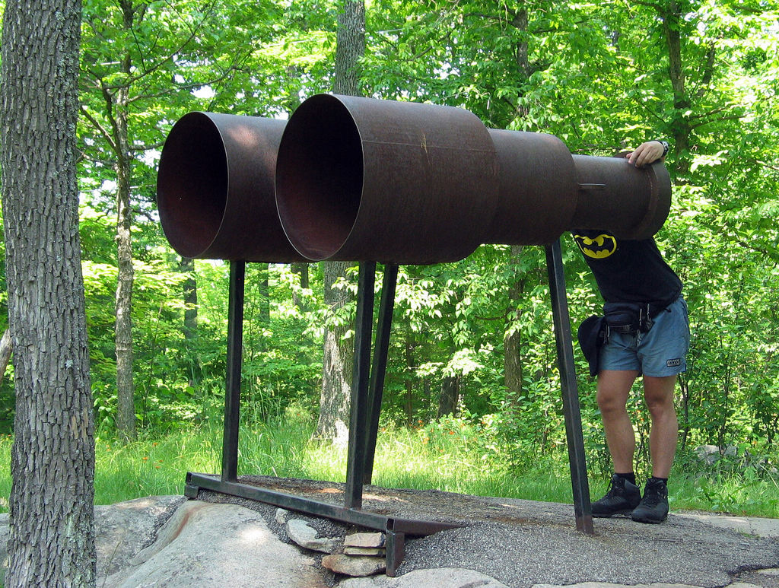
How do things look?
2

Slide 3

3

Slide 4
U.S. Leading Indicators
1970 – 2017*
Source: The Conference Board
Recession Periods
4
*Data through August 2017

Slide 5
Consumer Confidence
1978 – 2017*
Source: The Conference Board
Recession Periods
5
*Data through August 2017

Slide 6
Treasury Spread:
10 year bond rate less 3 month bill rate
1959 – 2017*
Source: Federal Reserve Bank of New York
Recession Periods
6
*Data through August 2017
Notes:
6
6

Slide 7
Treasury Spread:
Recession Probabilities
1960 – 2018*
Source: Federal Reserve Bank of New York
Recession Periods
*Data through August 2018
Note: Probability of recession in 1 year
7
Notes:
7
7

Slide 8
Job Openings
2001 – 2017*
Source: Bureau of Labor Statistics
Recession Periods
8
*Data through July 2017
Notes:
8
8

Slide 9
Overall Hourly Wage Growth
1998 – 2017*
Source: Bureau of Labor Statistics; Federal Reserve Bank of Atlanta
Recession Periods
*Data through August 2017
Note: 3-month moving average
9
Notes:
9
9

Slide 10
Labor Force Participation Rate (16 years and over)
1986 – 2014
Source: Bureau of Labor Statistics
Recession Periods
10

Slide 11
GDP
Potential Versus Actual
2000-2017*
Source: U.S. Congressional Budget Office; BEA
(Billions)
Recession Periods
$935.5
11
*Data through second quarter 2017

Slide 12
GDP
Potential Versus Actual
1980-2017*
Source: U.S. Congressional Budget Office; BEA
(Billions)
Recession Periods
12
*Data through second quarter 2017

Slide 13

Headwinds
Auto Sales
Widening Trade Deficit
13

Slide 14

Unknowns in Policy
14

Slide 15
President Trump’s Plan
We’re facing the potential for a positive change in Economic Growth Prospects.
It’s too early to tell how much will get through congress and how much will be implemented.
So, the jury is still out.
15

Slide 16
What can we expect if President Trump’s Tax and Economic Policies Pass
Short-term effects – faster growth due to personal and corporate tax cuts, reduced regulations and infrastructure spending.
Long-term effects – depend on the extent of the tax cuts, especially corporate tax cuts.
16

Slide 17
What can we expect if President Trump’s Tax and Economic Policies Pass
Higher Interest Rates and Higher Cap Rates
Higher Inflation
Higher after Tax Profits
Larger Deficits
Construction and Other Labor?
17

Slide 18
If done correctly, his economic policies can make a significant difference.
If not, the change will be less significant.
18

Slide 19

Reducing Regulations
Under President Trump
19

Slide 20
Reducing Regulations
Under President Trump
Withdrawn or delayed 860 proposed regulations in its first 5 months
Federal Agencies are expected to add 1,732 regulations.
  This is 20% drop when compared to 2016
President Trump has only been able to slow the growth of regulation.
There will still be more regulation.
20

Slide 21

More Regulation…
Another Confederate
Statue Bites the Dust
21

Slide 22

This Cycle is No Spring Chicken
22

Slide 23
U.S. BUSINESS CYCLE EXPANSIONS
Source: National Bureau of Economic Research
23

Slide 24
Average Annualized Quarterly GDP Growth Rates
During Economic Expansions
1949 – 2017
Source: Bureau of Economic Analysis, National Bureau of Economic Research
Expansion Period | Avg. Growth Rate
October 1949 – July 1953 | 6.4%
April 1958 – April 1960 | 6.2%
February 1961 – December 1969 | 4.9%
March 1975 - January 1980 | 4.5%
November 1970 – November 1973 | 4.4%
November 1982 – July 1990 | 4.3%
May 1954 – August 1957 | 3.8%
March 1991 – March 2001 | 3.6%
July 1980 – July 1981 | 3.2%
November 2001 – December 2007 | 2.8%
June 2009 - Present | 2.2%
24

Slide 25
Can the Expansion Last?
25

Slide 26
Yes!
26

Slide 27
Expansions don't die of old age.
27

Slide 28
They die because an economy becomes vulnerable to exogenous shocks or asset bubbles or a tightening in the credit market.
28

Slide 29
As recoveries get older, they become more vulnerable to shocks...
…Just as people get older they become more vulnerable to diseases.
29

Slide 30

What keeps me up at night?
30

Slide 31
What keeps me up at night?
Lack of political capital
Lack of consistency on immigration policy.
How close to full employment are we? How many people who left the labor force will come back? Where will construction and high tech workers come from?
Recovery/expansion was 91 months long when Trump was inaugurated. Can it last another 48 months?
31

Slide 32
Where does the economy currently stand
32

Slide 33

Consumers
33

Slide 34
Financial Obligation Ratio*
1980 – 2017**
Source: Federal Reserve
Recession Periods
*Ratio of mortgage and consumer debt (including auto, rent and tax payments) to disposable income.
**Data through the first quarter 2017
34
Notes:
34
34
34

Slide 35

Credit Use Under Control
35

Slide 36
U.S. Consumer Credit
1980 – 2017*
Source: Federal Reserve
(Trillions)
Recession Periods
*Data through July 2017
36
Revolving credit is $26 billion below its 2008 peak.
Notes:
36
36

Slide 37
Median Credit Score
Auto Loans**
2000-2017*
Source: New York Fed Consumer Credit Panel/Equifax
Recession Periods
*Data through 2017 Q2
** Credit Score is Equifax Riskscore 3.0; mortgages include first-liens only.
37

Slide 38
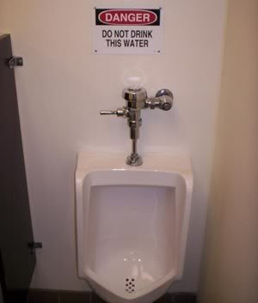
Consumer Liquidity Improving
38

Slide 39
U.S. Household Financial Assets
(Billions of Dollars, NSA)
1970 - 2017*
Source: Board of Governors of the Federal Reserve System
Recession Periods
39
*Data through second quarter 2017

Slide 40

No irrational exuberance
40

Slide 41
Cyclically Adjusted PE Ratio**
1950 – 2017*
Source: Robert Shiller, Yale University
Recession Periods
**Price earnings ratio is based on average inflation-adjusted earnings from the previous 10 years, known as the Cyclically Adjusted PE Ratio
41
*Data through September 2017

Slide 42

Net worth improved
42

Slide 43
U.S. Household Net Worth
(Billions of Dollars, NSA)
1970 – 2017*
Source: Board of Governors of the Federal Reserve System
Recession Periods
43
*Data through the second quarter of 2017

Slide 44

Real income growth
44

Slide 45
Real Disposable Personal Income Per Capita
1970-2017*
Source: Bureau of Economic Analysis
Recession
*Data through the second quarter 2017
45

Slide 46

Inflation low
46

Slide 47
U.S. Consumer Price Index
Annual Percent Growth
1960 – 2017*
Source: Bureau of Labor Statistics
Recession Periods
47
*Data through August 2017

Slide 48

No capacity issues
48

Slide 49
Capacity Utilization Rate
1970 – 2017*
Source: Board of Governors of the Federal Reserve System
Recession Periods
49
*Data through August 2017

Slide 50

Fed policy still expansive
50

Slide 51

Housing
51

Slide 52
U.S. National Case-Shiller Index
1987 – 2017*
Source: S&P CoreLogic Case-Shiller Indices
Recession Periods
52
*Data through June 2017

Slide 53

Conclusion
The possibility of a recession in the near future is Low!
53

Slide 54
Greater
Phoenix
54
Notes:
54

Slide 55

Welcome! Have a seat please
55

Slide 56
Employment Growth
From Bottom of Recession to Now
Seasonally Adjusted
Source: BLS
Area | % Change | % of Arizona Growth | 2016 Average Annual Wages
United States | 12.5% |  | $53,515
Arizona | 15.9% | 100.0% | $48,089
Greater Phoenix | 19.8% | 88.3% | $50,508
Greater Tucson | 6.6% | 6.1% | $42,021
Balance of State | 6.2% | 5.5% | $35,890
Note: Start of Recession Sept. 2010 to August 2017;
Wages for Private industries
56

Slide 57
Arizona Employment Growth
Arizona’s Rank Out of 50 States
Source: Arizona State University, U.S. Bureau of Labor Statistics
Year | Rank
1994 | 2
1995 | 2
1996 | 2
1997 | 2
1998 | 1
1999 | 2
2000 | 5
2001 | 9
2002 | 10
2003 | 4
2004 | 2
2005 | 2
Year | Rank
2006 | 2
2007 | 17
2008 | 46
2009 | 49
2010 | 49
2011 | 27
2012 | 8
2013 | 9
2014 | 17
2015 | 11
2016 | 9
2017* | 13
57
*YTD August 2017 vs. YTD August 2016
Notes:
57
57
57
57

Slide 58
Phoenix-Mesa-Scottsdale Employment Growth
(Ranking among all metro areas greater than 1,000,000)
Source: Arizona State University, U.S. Bureau of Labor Statistics
Year | Rank | # MSA’s
1994 | 1 | 19
1995 | 1 | 20
1996 | 1 | 21
1997 | 2 | 22
1998 | 1 | 23
1999 | 3 | 24
2000 | 7 | 25
2001 | 7 | 26
2002 | 5 | 25
2003 | 3 | 25
2004 | 3 | 25
2005 | 1 | 26
Year | Rank | # MSA’s
2006 | 1 | 27
2007 | 10 | 29
2008 | 25 | 29
2009 | 23 | 24
2010 | 23 | 23
2011 | 14 | 25
2012 | 10 | 28
2013 | 7 | 29
2014 | 15 | 31
2015 | 11 | 32
2016 | 9 | 33
2017* | 10 | 34
58
*YTD August 2017 vs. YTD August 2016
Notes:
58
58
58
58

Slide 59
Why has
Greater Phoenix’s growth in this cycle been subpar relative to its
historical norm?
59

Slide 60
Sub normal national recovery
(2) Slowdown in population flows
Nationally and in Arizona
(3) Other (Unknowns)
60

Slide 61
Growth itself is an economic driver in Greater Phoenix–
People moving to the State and Greater Phoenix create demand for goods and services that create more jobs.
When you grow around 1.8% instead of 3.5%, the part of the economy that is based on servicing new people shrinks.
61

Slide 62
Employment Growth
Trough to Peak
Greater Phoenix Employment, Seasonally Adjusted
Source: BLS
Recession | Emp. Trough | Emp. Peak | % Growth | Monthly Growth Rate
1974-1975 | Jun-75 | Aug-81 | 53.7% | 0.58%
1981-1982 | Sep-82 | Jun-90 | 50.7% | 0.44%
1991 | Aug-91 | Mar-01 | 60.7% | 0.41%
2001 | Dec-01 | Aug-07 | 21.7% | 0.29%
2007-2009 | Sep-10 | Aug-17 | 19.8% | 0.22%
*Data through August 2017
62

Slide 63
Population Growth after Recessions
Greater Phoenix
Source: Office of Economic Opportunity
Years | Population at the Start of recovery | Population at the End of recovery | % Growth | APR
1975-1980 | 1,337,700 | 1,606,300 | 20.1% | 3.7%
1981-1990 | 1,658,988 | 2,247,200 | 35.5% | 3.4%
1991-2001 | 2,301,825 | 3,360,062 | 46.0% | 3.9%
2001-2007 | 3,360,062 | 4,087,390 | 21.6% | 3.3%
2009-2016 | 4,186,130 | 4,550,388 | 8.7% | 1.2%
63

Slide 64

Fewer people mean fewer houses & less commercial construction.
64

Slide 65
Greater Phoenix Employment*
Annual Percent Change 1976–2018**
Source: Office of Economic Opportunity
Pre-2008 Avg. 4.8%
*Non-agricultural wage & salary employment. Changed from SIC to NAICS reporting in 1990.
**2017 & 2018 forecasts from Elliott D. Pollack & Co. as of July 2017.
Recession Periods
65

Slide 66

Where are the Inflows of Population?
66

Slide 67
Greater Phoenix Population
Source: U.S. Bureau of Census; Office of Economic Opportunity; UofA Forecasting Project
Decade Ending | Population | APR
1970 | 1,039,807 | 3.5%
1980 | 1,600,093 | 4.4%
1990 | 2,249,116 | 3.5%
2000 | 3,275,362 | 3.8%
2010 | 4,200,427 | 2.5%
2015 | 4,482,906 | 1.3%
2020* | 4,897,713 | 1.8%
2025* | 5,362,566 | 1.8%
*Forecasts from UofA
1970-2010 10 year period
2010-2025 5 year period
67
Notes:
67

Slide 68
Total U.S. Movers
Source: U.S. Census Bureau
(1000’s)
Recession Periods
Note: Includes all movers except movers within same county
68

Slide 69
Total Movers as a % of
Total U.S. Population
Source: U.S. Census Bureau
Recession Periods
Note: Includes all movers except movers within same county
69

Slide 70
Arizona Capture Rate
Source: U.S. Census Bureau
Recession Periods
Note: Does not include in-state movers;
Net migration numbers.
70

Slide 71
Effect of Slower Migration on
Employment Growth in Arizona
Source: U.S. Census Bureau; Office of Economic Opportunity; EDPCo
 | 2014 | 2015 | 2016
Actual Job Growth Rate | 2.0% | 2.6% | 2.6%
Potential Job Growth | 3.7% | 4.1% | 3.8%
Estimated using 2001-2005 average migration patterns and Arizona’s capture rate
71

Slide 72
Conclusion:
Due to the lack of national, international, and in state population flows:
1. Jobs that would have been created by the domestic demand from people moving here slowed.
2. It took longer to absorb the excess inventory of single family, office, etc. Construction employment has suffered.
72

Slide 73
Population Growth 2016
Source: U.S. Census Bureau
Alaska
20
5
13
6
3
46
2
19
1
7
32
Hawaii
8
41
10
Growing
9
Top 10
4
Declining
73
Notes:
73
73
73
Updated 5/17/2013

Slide 74
Greater Phoenix Population
Annual Percent Change 1975–2018*
Source: Office of Economic Opportunity, EDPCo
Recession Periods
Pre-2008 Avg. 3.5%
*Estimates for 2013, 2014, 2015 and 2016 and forecasts for 2017 and 2018 from Elliott D. Pollack & Co. as of July 2017.
74

Slide 75
Greater Phoenix Population
Annual Net Change 1975–2018*
Source: Office of Economic Opportunity, EDPCo
Recession Periods
*Estimates for 2013, 2014, 2015 and 2016 and forecasts for 2017 and 2018 from Elliott D. Pollack & Co. as of July 2017.
75

Slide 76
SRP Residential Utility Hookup Growth
Greater Phoenix 2003 – 2017*
Source: SRP
Recession Period
76
*Data through June 2017
Notes:
Updated 06/02/2013

Slide 77
APS: Slowest Growth in over 50 years
1954 – 2017*
Source: APS
*Data through the second quarter 2017
77
Notes:
update

Slide 78
How quickly are population flows going to recover?
78

Slide 79

SLOWLY!
Still buffering, seriously?
79

Slide 80
Greater Phoenix Population
Source: Office of Economic Opportunity; EDPCo; UofA Forecasting Project
Year | Population | % Change
2010 | 4,200,428 | 0.3%
2011 | 4,227,601 | 0.6%
2012 | 4,273,897 | 1.1%
2013 | 4,333,732 | 1.4%
2014 | 4,398,738 | 1.5%
2015 | 4,474,324 | 1.7%
2016 | 4,550,388 | 1.7%
2017* | 4,627,744 | 1.7%
2018* | 4,711,044 | 1.8%
EDPCo Re-benched Estimates 2013-2016
*Forecast from EDPCo
80
Notes:
80

Slide 81
Housing Market Outlook
81

Slide 82

The Parade of Horribles
for housing has become a
Parade of Positives
82

Slide 83
What is keeping potential buyers out of the housing market?
Parade of positives:
Negative Equity
Foreclosures
Millennials
Student Loans
Tougher Loan Standards
83

Slide 84
Homeowners Above Water
Source: CoreLogic; American Community Survey
Loan-to-Value* | 2011 |  | 2016
 | Total | % of Total | Total | % of Total
Less than 70% | 45,655,578 | 61.5% | 58,796,164 | 77.7%
Less than 80% | 51,525,326 | 69.4% | 66,195,006 | 87.5%
Less than 90% | 57,493,726 | 77.4% | 71,571,498 | 94.6%
Total | 74,264,435 |  | 75,652,569
Includes Homeowners without a mortgage.
84

Slide 85
Homeowners Above Water
Source: CoreLogic; American Community Survey
Loan-to-Value* | 2011 | 2016 | Difference
Less than 70% | 45,655,578 | 58,796,164 | 13,140,586
Less than 80% | 51,525,326 | 66,195,006 | 14,669,680
Less than 90% | 57,493,726 | 71,571,498 | 14,077,772
Includes Homeowners without a mortgage.
85

Slide 86
Maricopa County Foreclosure Lag
2002–2024
Source: Information Market
Recession Periods
86

Slide 87

Millennials
87

Slide 88
U.S. Birth Index
1909-2016
Source: U.S. Census Bureau; Harvard Joint Center for Housing Studies
Baby Boomers
1945-1964
(Ages 50-69)
78.7 M
Gen X
1965-1984
(Ages 30-49)
69.5 M
88
Notes:
88
88

Slide 89
Homeownership Rates by Age Group
Source: 2015 American Community Survey 1-Year Estimates
Householder Age | % of Total | Current Population
15 to 24 years | 12.1% | 43,511,027
25 to 34 years | 34.5% | 44,677,243
35 to 44 years | 51.7% | 40,470,156
45 to 54 years | 64.2% | 42,786,679
55 to 59 years | 71.1% | 21,980,108
60 to 64 years | 75.5% | 19,483,036
65 to 74 years | 81.8% | 28,630,330
75 to 84 years | 81.7% | 14,233,534
85 years and over | 70.2% | 6,380,331
Total | 60.5% | 262,152,444
89

Slide 90
Household Formation
1990-2017
Source: U.S. Census Bureau
(1000’s)
*Data through second quarter 2017
Not a continuous series
90

Slide 91
Net change in Household Formation
2002-2017
Source: U.S. Census Bureau
(1000’s)
91

Slide 92
Baby Boomers Versus Millennials
Aged 25-34
Source: Bowling Green State University; 1980 Decennial Census; 2015 American Community Survey
 | Baby Boomers (1980) | Millennials (2015)
Married | 68% | 40%
Separated/Divorced | 12% | 7%
Never Married | 20% | 53%
Live in Independent Households | 84% | 59%
Lived with Parents/Grandparents | 9% | 22%
Home Ownership | 60% | 43%
92

Slide 93


When you delay marriage you delay children. That delays housing. That delays demand for housing “stuff”.
Single Married
93

Slide 94

Total Student Loan Debt Has Quintupled!
94

Slide 95
Total Student Loan Balances
Billions of Dollars
Source: Federal Reserve Bank of New York Consumer Credit Panel / Equifax
Year | Total
2004 Q2 | $262.9
2005 Q2 | $374.4
2006 Q2 | $438.9
2007 Q2 | $514.0
2008 Q2 | $586.3
2009 Q2 | $675.4
2010 Q2 | $761.7
2011 Q2 | $851.4
2012 Q2 | $914.0
2013 Q2 | $994.0
2014 Q2 | $1,118.0
2015 Q2 | $1,190.0
2016 Q2 | $1,259.0
2017 Q2 | $1,344.0
95
Notes:
95
95

Slide 96
% of Adults
with Outstanding Student Loan
Source: Pew Research Center
96

Slide 97
Median Loan Debt Amount by Education Level
Source: Pew Research Center
Education Level | Amount Owed
All borrowers | $17,000
Less than bachelor’s | $10,000
Bachelor’s degree | $25,000
Postgraduate degree | $45,000
97

Slide 98
Expenses that Delayed Saving for a Down Payment or Home Purchase – 2017 By Age
Source: National Association of Realtors 2017
 | All Buyers | 36 and younger | 37 to 51 | 52 to 61 | 62 to 70
Those who said “Saving for Downpayment was Most Difficult Task in Buying Process”: | 13% | 23% | 13% | 4% | 3%
Reasons Why:
Student Loans | 49% | 55% | 29% | 9% | 7%
Credit Card Debt | 40% | 31% | 41% | 29% | 31%
Car Loan | 34% | 32% | 21% | 14% | 10%
Child Care Expenses | 18% | 12% | 15% | 1% | 4%
Health Care Costs | 14% | 9% | 10% | 13% | 11%
Other | 15% | 18% | 26% | 52% | 48%
Median Years Delayed | 3 | 3 | 4 | 3 | 4
98
Notes:
98
98

Slide 99

99

Slide 100
Student Loan Impact on Economy
If people are paying student loan debt, they are not buying houses, furniture, beers, etc. Unless incomes are higher because of their degree.
100

Slide 101
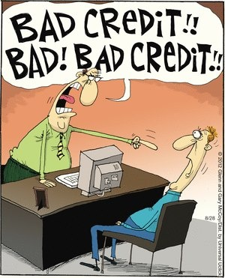
Credit Availability
101

Slide 102
Mortgage Credit Availability Index
2012 – 2017*
March 2012 = 100
Source: Mortgage Bankers Association
185
165
145
125
105
85
2012
2013
2014
2015
2016
2017
*A decline in the MCAI indicates that lending standards are tightening,
while increases in the index are indicative of loosening of credit.
*Data through July 2017
102

Slide 103
Mortgage Credit Availability Index
2004 – 2017*
March 2012 = 100
Source: Mortgage Bankers Association
Recession Periods
1,000
750
500
250
0
2005
2007
2009
2011
2013
2015
2017
*A decline in the MCAI indicates that lending standards are tightening,
while increases in the index are indicative of loosening of credit.
*Data through July 2017
103

Slide 104
Median Credit Score
Mortgage Originations**
2000-2017*
Source: New York Fed Consumer Credit Panel/Equifax
Recession Periods
*Data through 2017 Q2
** Credit Score is Equifax Riskscore 3.0; mortgages include first-liens only.
104

Slide 105
Purchase Application Distribution
by Credit Score
2006
Source: CoreLogic
1.2%
1.0%
Originations
Applications
0.8%
0.6%
0.4%
0.2%
0.0%
500
550
600
650
700
750
800
850
105

Slide 106
Purchase Application Distribution
by Credit Score
2016
Source: CoreLogic
1.2%
1.0%
Originations
Applications
0.8%
0.6%
0.4%
0.2%
0.0%
500
550
600
650
700
750
800
850
106

Slide 107

The housing recovery is likely to continue.
107

Slide 108
Single Family Permits
Greater Phoenix 1975–2018*
Source: RL Brown & Elliott D. Pollack & company
# Permits
(000)
*2017 and 2018 forecast is from Elliott D. Pollack & Company
108
Notes:
108

Slide 109
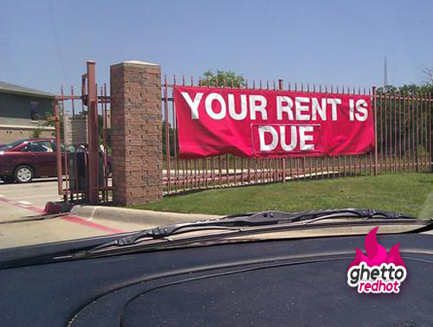
Multi-Family
109

Slide 110
Apartments
Births ➔26 year lag
1955-2038
Source: U.S. Census Bureau
2017
110
Notes:
110
110

Slide 111
U.S. Median Age at First Marriage
1890-2016
Source: U.S. Census Bureau
111

Slide 112
Retirement Home Cycle
Births ➔ 65 year lag
1994-2076
Source: U.S. Census Bureau
112
Notes:
112
112

Slide 113
Greater Phoenix Multi-Family Average Rent
Percent Change a Year Ago
2004 – 2017*
Source: RealData Inc.
Recession Periods
*Data through the second quarter 2017
113

Slide 114
Multi-Family Year-End Vacancy Rates
Greater Phoenix 1975–2018*
Source: ASU Realty Studies / Berkadia**
Recession Periods
*2017 & 2018 are forecasts from Elliott D. Pollack & Co.
**Data prior to 2005 is from ASU
114
Notes:
114
114

Slide 115
Multi-Family Pipeline
Source: Anonymous
Year | Potential New Supply
2017 | 6,125
2018 | 6,841
2019 | 6,309
115

Slide 116
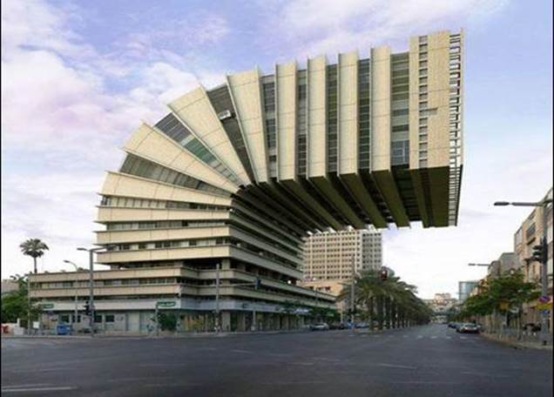
OFFICE
116
Notes:
116
116

Slide 117
Office Space Year-End Vacancy Rates
Greater Phoenix 1986–2018*
Source: CBRE
Recession Periods
117
*2017 & 2018 are forecasts from CBRE.
Notes:
24
117
117
117

Slide 118
Greater Phoenix Office Market*
Source: CBRE
Year | Absorption (sf) | Chg in Inventory (sf)
2005 | 3,119,293 | 7,987
2006 | 3,245,888 | 2,320,302
2007 | 1,500,704 | 4,905,374
2008 | (603,112) | 3,402,646
2009 | (667,329) | 1,798,415
2010 | 233,670 | 2,011,404
2011 | 1,857,433 | 3,144,910
2012 | 2,020,529 | 973,282
2013 | 1,721,366 | (35,566)
2014 | 1,816,411 | 1,107,906
2015 | 3,704,039 | 3,763,828
2016 | 3,219,853 | 1,045,155
2017** | 1,064,127 | 1,535,041
*All Leased multi-tenant space greater than 10,000 SF.
**Data through the second quarter 2017
118
Notes:
10/08/2013

Slide 119
As of 2017, the following markets have vacancy rates under 10%
Deer Valley/Airport
Tempe
Scottsdale South
PS Peak
Source: Paul Johnson
119

Slide 120
As of the second quarter 2017,
there were 1.5 million square feet of total office space
under construction including
over 700,000 square feet of speculative office space.
Source: CBRE
120
Notes:
120
120

Slide 121
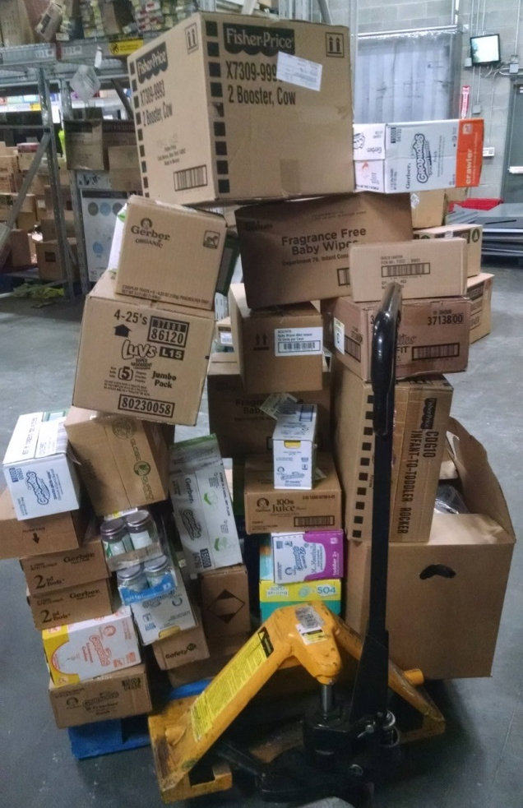
INDUSTRIAL
121
Notes:
121
121

Slide 122
Industrial Space Vacancy Rates
Greater Phoenix 1980 – 2018*
Source: CBRE
Recession Periods
122
*2017 & 2018 are forecasts from CBRE
Notes:
24
122
122
122

Slide 123
Greater Phoenix Industrial Market
Source: CBRE
Year | Absorption (sf) | Chg in Inventory (sf)
2005 | 12,361,368 | 7,072,477
2006 | 6,179,533 | 7,829,959
2007 | 8,359,835 | 13,914,181
2008 | 629,838 | 13,467,215
2009 | (4,649,352) | 4,753,218
2010 | 4,455,097 | 2,451,202
2011 | 7,696,277 | 1,954,037
2012 | 6,093,132 | 3,358,724
2013 | 8,783,982 | 8,902,571
2014 | 6,214,680 | 6,791,313
2015 | 7,046,663 | 3,966,434
2016 | 9,497,677 | 5,136,644
2017* | 4,791,472 | 3,651,139
*Data through the second quarter 2017
123
Notes:
10/08/2013

Slide 124
As of the second quarter 2017,
there was 4.6 million square feet of total industrial space under construction including
2.7 million square feet
of speculative industrial space.
Source: CBRE
124
Notes:
124
124

Slide 125
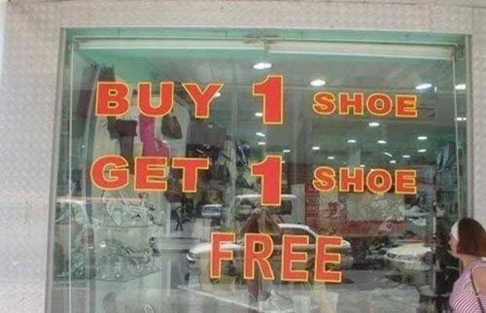
RETAIL
125

Slide 126
Retail Space Vacancy Rates
Greater Phoenix 1985–2018*
Source: CBRE**
Recession Periods
*2017 & 2018 are forecasts from CBRE
** Data prior to 1992 is from Grubb & Ellis
126
Notes:
126
126

Slide 127
Greater Phoenix Retail Market
Source: CBRE
Year | Absorption (sf) | Chg in Inventory (sf)
2005 | 6,708,155 | 6,248,789
2006 | 5,244,597 | 4,582,618
2007 | 9,409,985 | 11,104,865
2008 | 3,395,986 | 6,229,205
2009 | (1,117,100) | 4,405,985
2010 | (75,352) | 902,380
2011 | (152,647) | 24,543
2012 | 1,879,005 | 184,932
2013 | 1,579,202 | (325,959)
2014 | 1,487,313 | (49,225)
2015 | 1,150,192 | 164,859
2016 | 1,321,833 | 1,204,766
2017* | 967,854 | 634,224
*Data through the second quarter 2017
127
Notes:
10/08/2013

Slide 128
As of the second quarter 2017,
there were 1.2 million square feet of total retail space
under construction.
Source: CBRE
128
Notes:
128
128

Slide 129
E-Commerce Retail Sales as a Percent of Total Sales
2000 – 2017*
Source: U.S. Census Bureau
Recession Periods
129
*Data through the second quarter 2017

Slide 130
Super-Stores and Internet Sales Cannibalization
Percentage of total sales by retailer type
1992 - 2017
Source: U.S. Census
Recession Periods
130
*Data through July 2017
Notes:
130
130

Slide 131
Cap Rates by Product Type
1984 – 2017*
Source: ACLI
Recession Periods
*Data trough March 2017
131

Slide 132

Overall Conclusions:
132

Slide 133

Continued Expansion
for now!
133

Slide 134

How rapid growth will be
is up in the air.
134
Notes:
134

Slide 135

Until new policies are put in place
not much will change.
135
Notes:
135

Slide 136
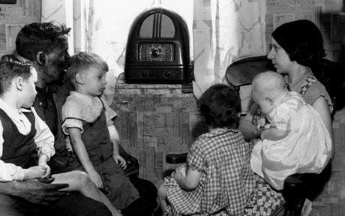
Stay tuned!
136

Slide 137
Greater Phoenix Forecasts
 | Actuals |  | Forecast
 | 2015 | 2016 | 2017 | 2018
Population | 1.6% | 1.7% | 1.7% | 1.8%
Employment | 3.3% | 3.1% | 2.6% | 2.4%
Construction Employment | 3.5% | 5.8% | 5.0% | 5.0%
Manufacturing Employment | 1.1% | 0.7% | 1.3% | 1.2%
Retail Sales | 8.9% | 4.4% | 3.8% | 3.4%
Single Family Permits | 46.7% | 11.0% | 10.0% | 10.0%
Personal Income | 4.8% | 4.8% | 4.4% | 4.5%
137

Slide 138
For a quick analysis of important economic data released each week, subscribe to the
Monday Morning Quarterback www.arizonaeconomy.com
(Click on Subscribe to MMQ)
138

